Slide 1
Final presentation
By Callum Hurd and Ralph Davies

Slide 2

Introduction
We want to discuss all of the second half of the project
Creation of synthetic data in python and in R
Creation of functions for a trading algorithm
Drawbacks of the methods we have used
Backtesting environments
Machine learning for trading
Results of the Machine Learning

Slide 3
Iterations of our synthetic data in R
We know that a stock price over long periods of time cannot accurately be modelled by a single GBM
Looking at stock price movement over the course of a few years you may come to a conclusion about the stability of the drift and volatility term when there are no external factors affecting the stock but around events such as stock splits, Dividend payments and earnings reports you may be under the impression that the volatility and drift change.
Luckily these are pre determined events so we can model the stock price with multiple GBMs at predetermined time points which represent these events.

Slide 4
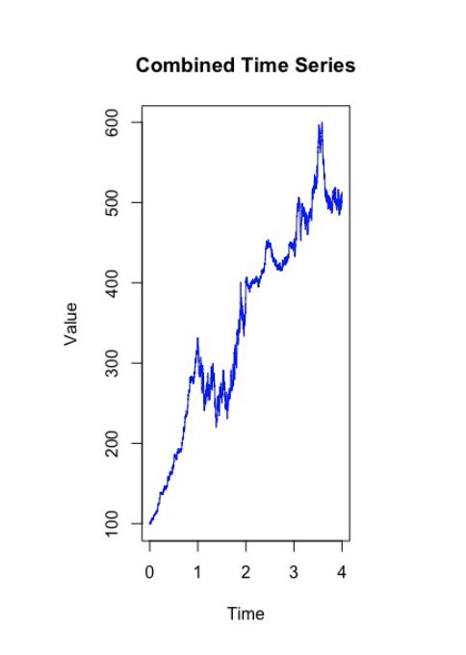
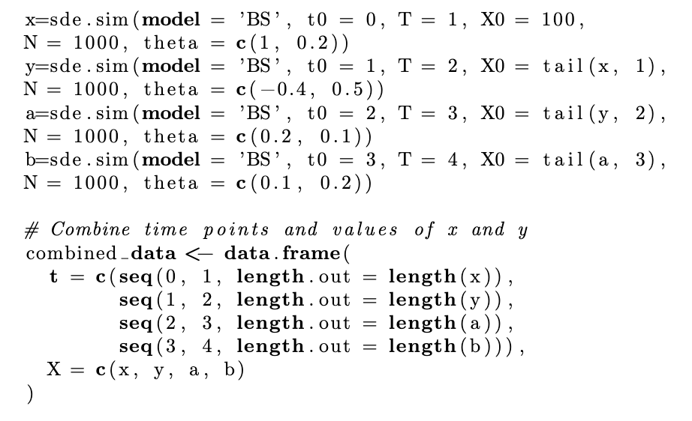
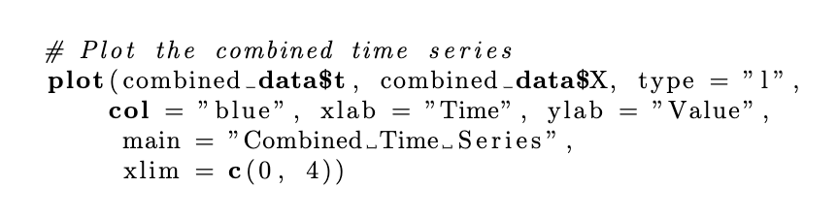
Predetermined changepoints

Slide 5
Moving to random change points
This model is only accurate if we have pre determined external factors affecting the stock price and we know exactly how they will affect the model whether that be a positive or negative affect.
This isn't very realistic in the majority of cases, but we can usually take a guess at how the model will be affected by external factors if we know roughly where they are.
If we don't know where they will be, we can make a guess of the rate they appear and draw from an exponential distribution to give us a better estimate.
This is what we do on the next slide ( This is input for completeness, after this section we move to python for better packages and faster code)

Slide 6
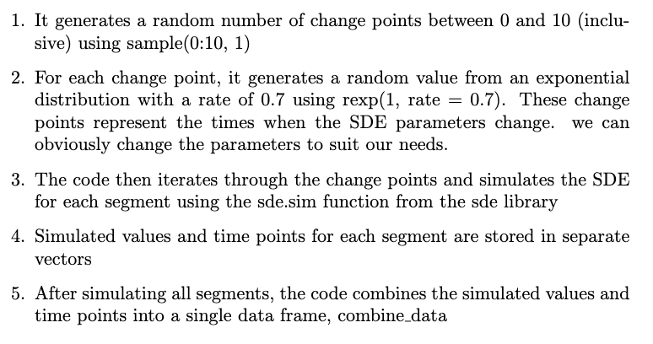
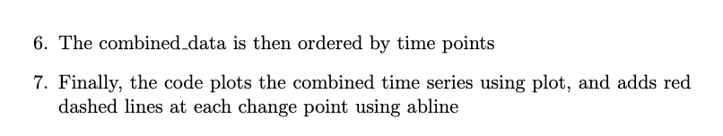

Slide 7
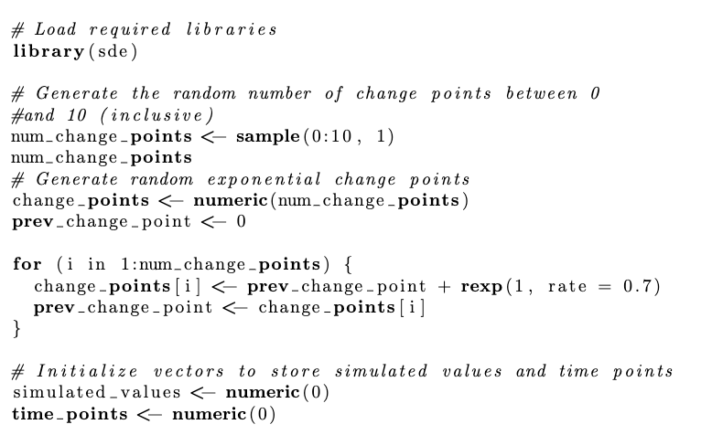

Slide 8
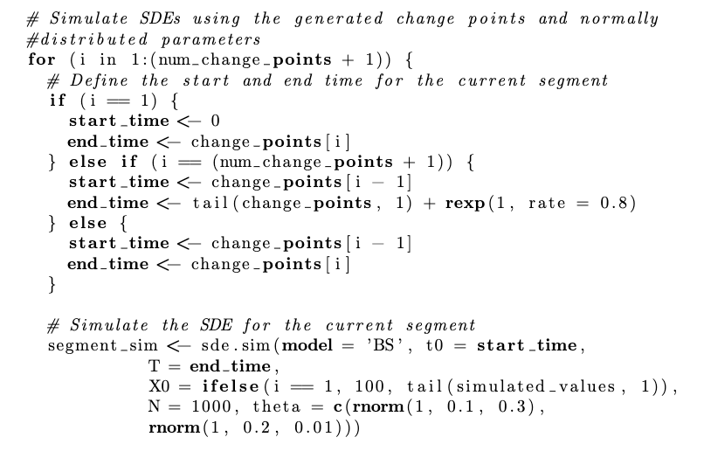

Slide 9
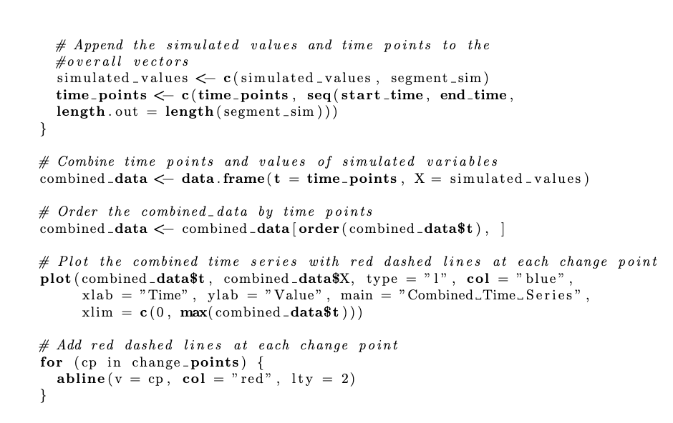

Slide 10
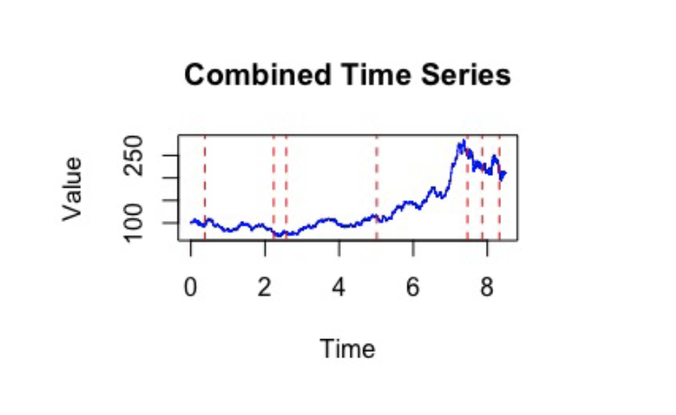

Slide 11
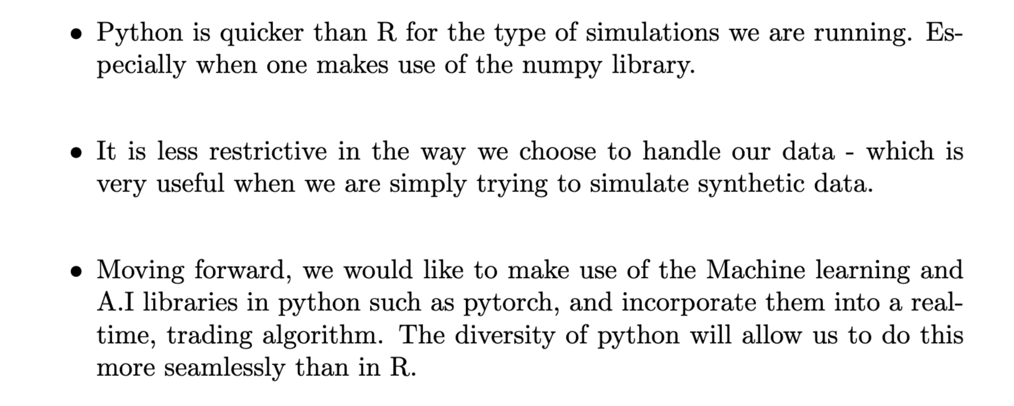



Switching to python

Slide 12
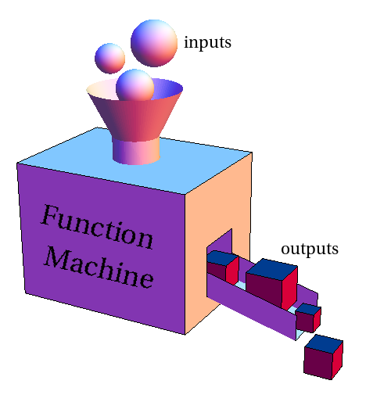
Functions and their uses
It would be tedious to go through every function that we created in python, so we will briefly discuss the overall architecture and how things fit together.
Functions worth noting:
gbm(mu, sig, S0, num_points, seed)
Multiple_gbm_sew(mu_arr, sig_arr, S0, N_arr)
mle_finder () [more on this later]
GBM

Slide 13
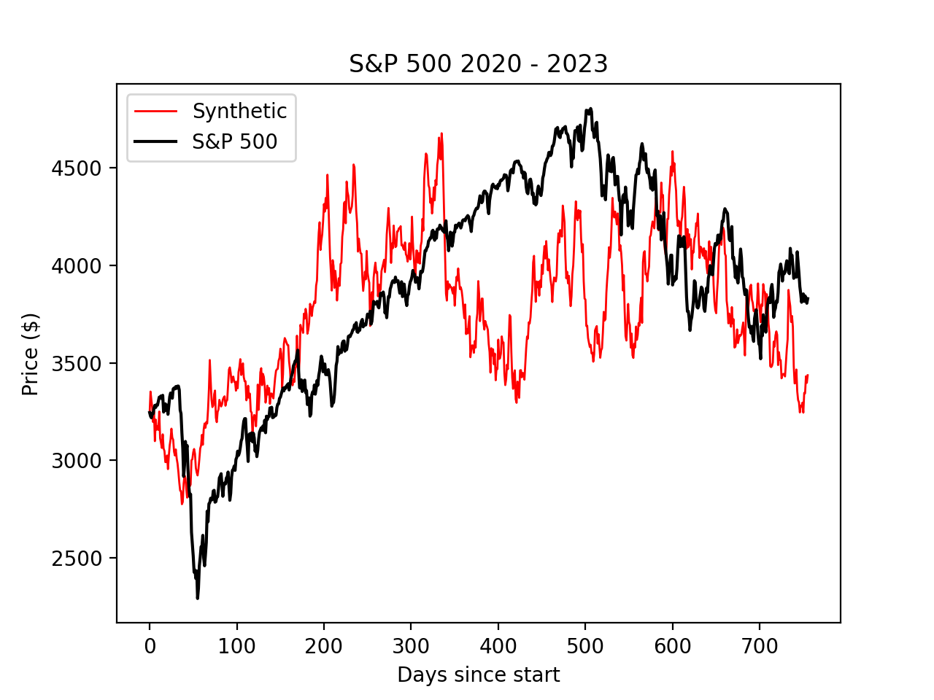
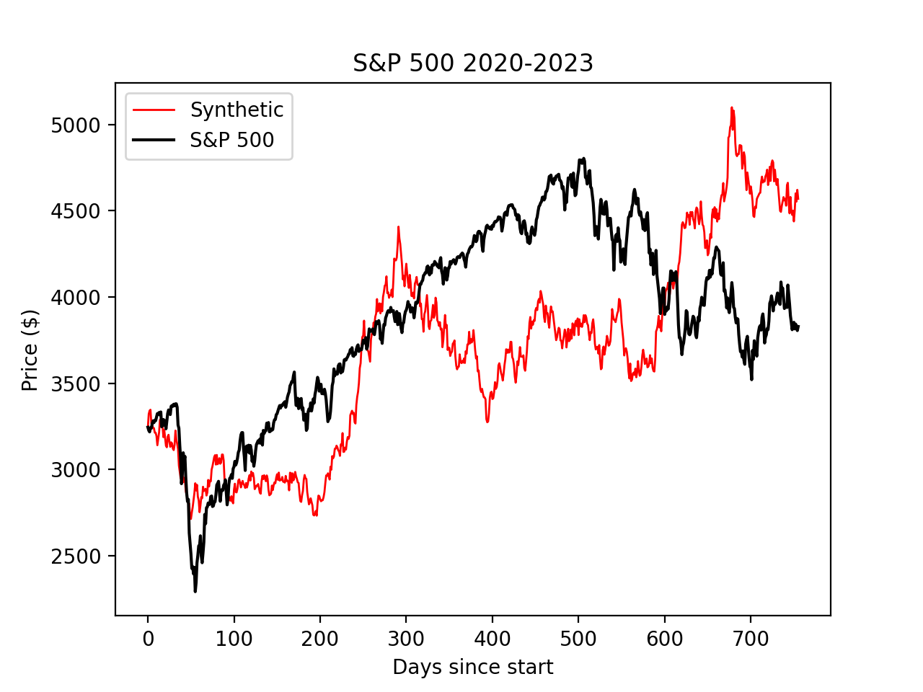
Brief example: Modelling the S&P 500
Single GBM
Multiple gbm

Slide 14
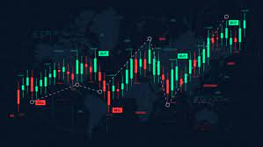
What do we do with this?
Our goal now is to implement the model within a trading algorithm, and see if it can be used to generate a profit. How can we manage this?
Be able to learn the values of the parameters.
Identify a set of rules of when and where to make a trade based off of these parameters.
To begin, we go over some of the necessary methods required to perform the above.

Slide 15
The MLE method
Although stock price does not necessarily follow a GBM path, it provides a decent approximation over small intervals whilst also keeping the elegant properties like markovianity and the fact it is distributed with a log normal distribution
The MLE method uses the log normal distribution and its likelihood to give appropriate estimates for what the drift and volatility term may be given the data

Slide 16
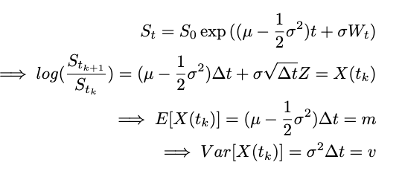
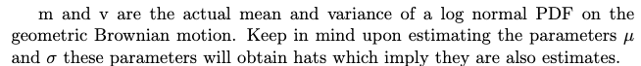
relabelling

Slide 17
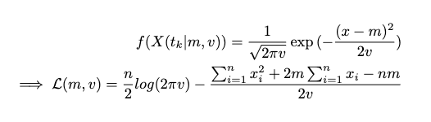
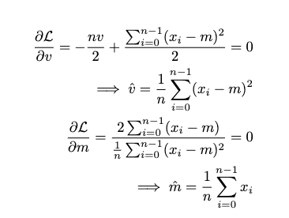
Likelihood of normal distribution
Taking derivatives of log likelihood
So we can now find m and v hat using the data

Slide 18
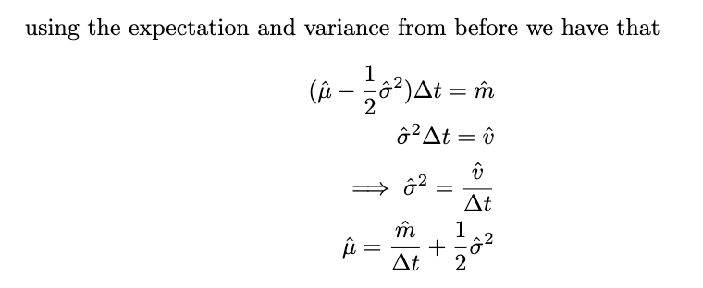
Therefore we have explicit formulas for the drift and volatility estimators using functions of the data. For our uses we set delta t to be 1 given that on any time frame we are always looking at 1 day or 1 minute so as long as we are consistent the estimations will be consistent.

Slide 19
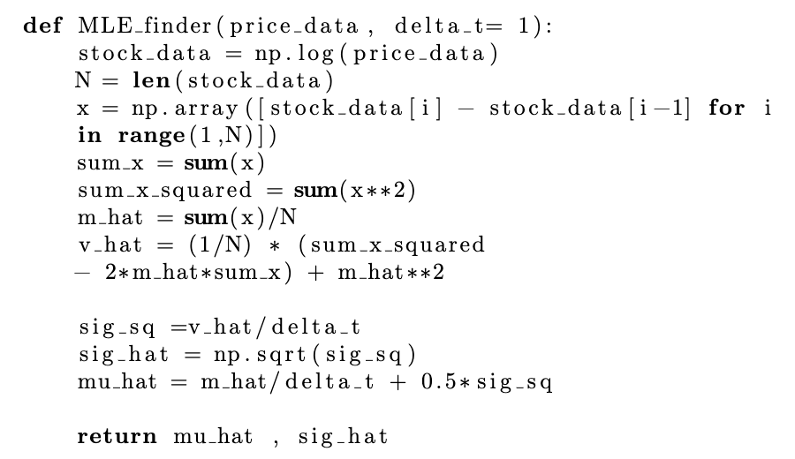
MLE_finder function
note : this could work with a different sde using pseudo likelihood methods and the distribution of the approximation scheme
Now that we have the results on the previous slides, we can easily create code which finds the estimates using the data

Slide 20
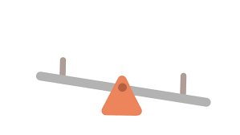
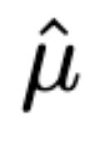
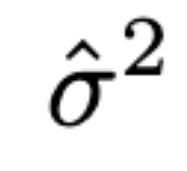
Drawbacks of the MLE method
Significant variation is present in parameter estimates, especially for small sample size.
Requires extremely high resolution data.
Interdependence of mu and sigma estimates

Slide 21
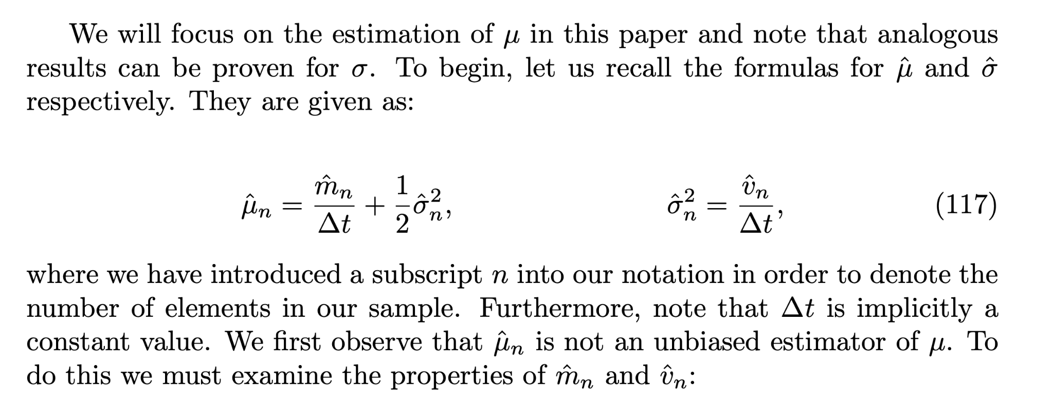
Drawbacks of the MLE method

Slide 22
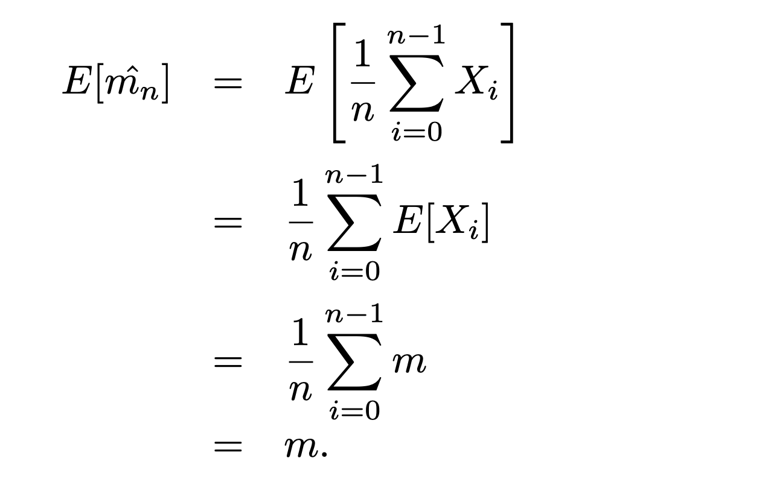
Drawbacks of the MLE method
Note: we are considering m_hat as a random variable here.

Slide 23
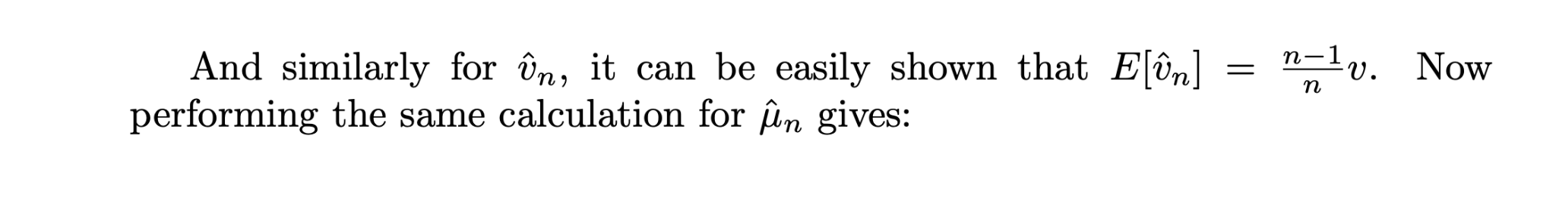
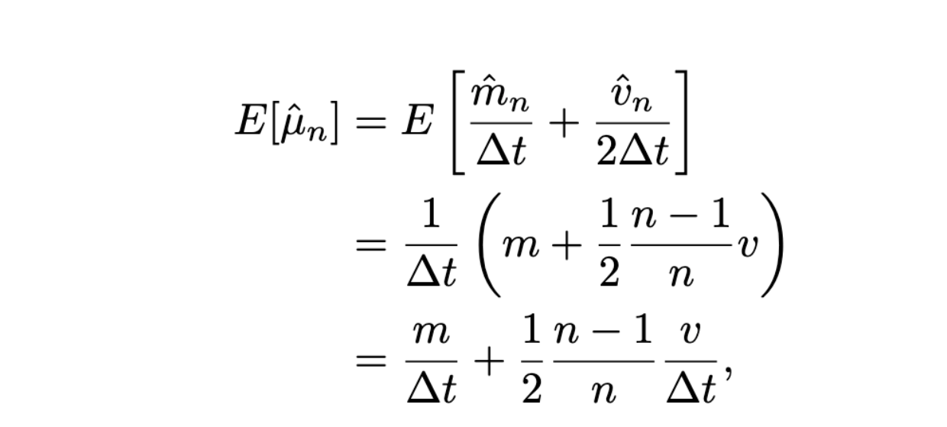
Drawbacks of the MLE method
So it turns out that our estimate for the drift is not quite unbiased. But for large enough n, this rapidly becomes only a small issue.

Slide 24
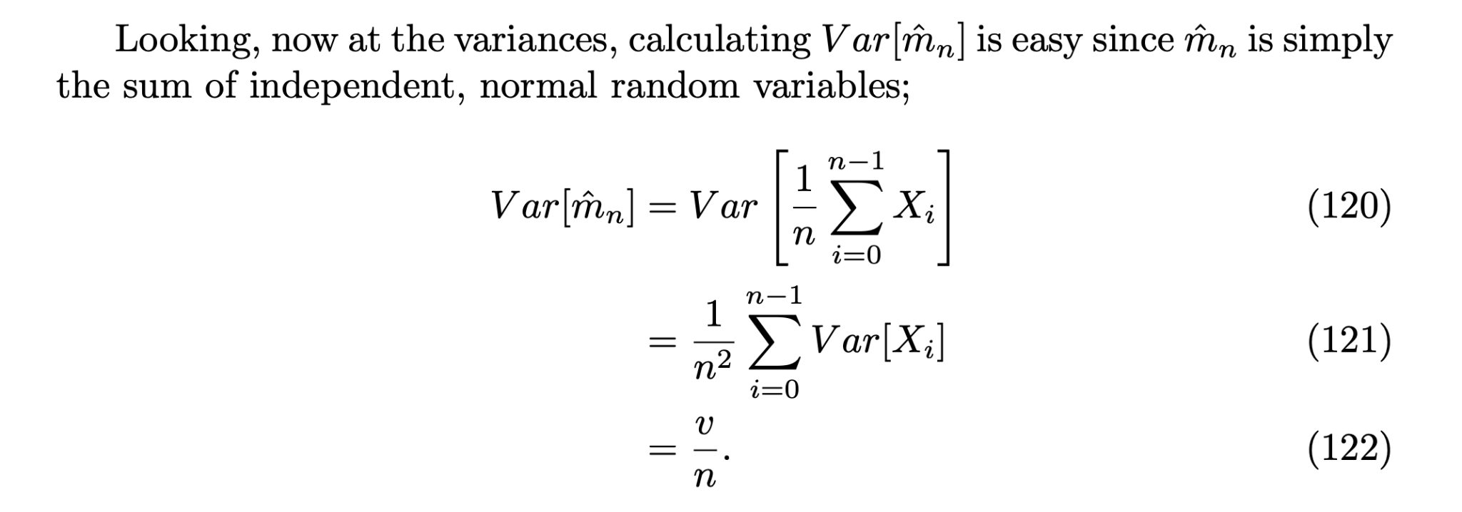
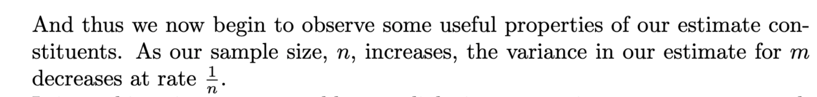
Drawbacks of the MLE method

Slide 25
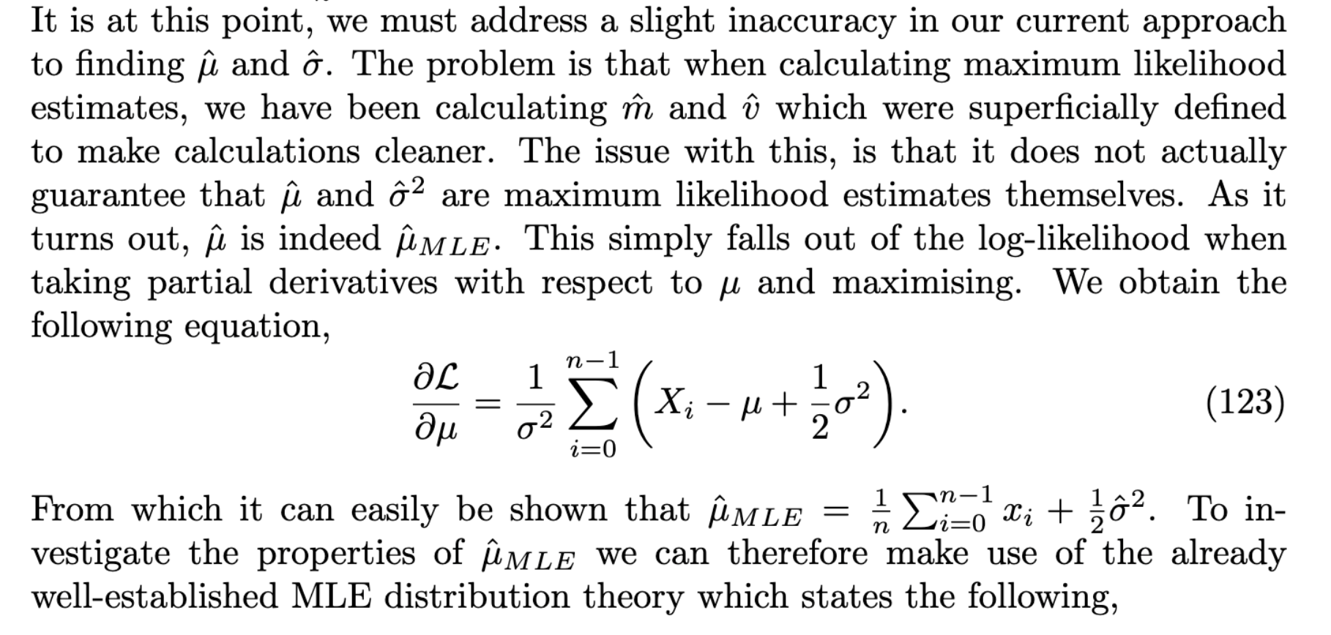
Drawbacks of the MLE method

Slide 26
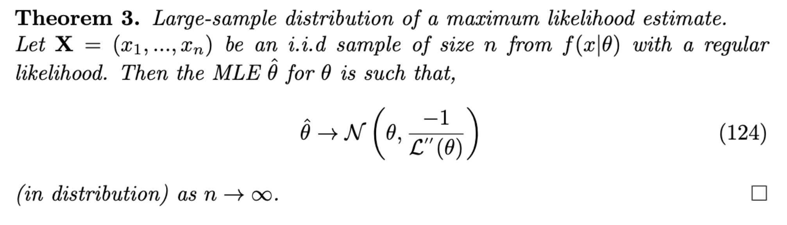
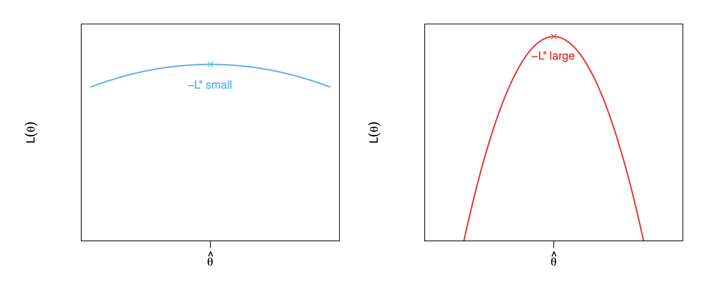
Drawbacks of the MLE method

Slide 27
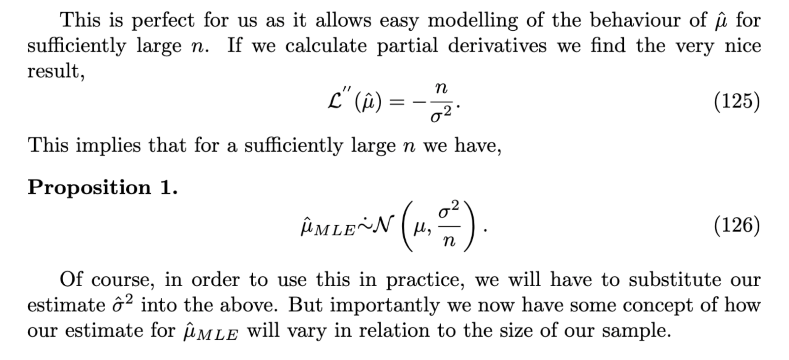
Drawbacks of the MLE method

Slide 28
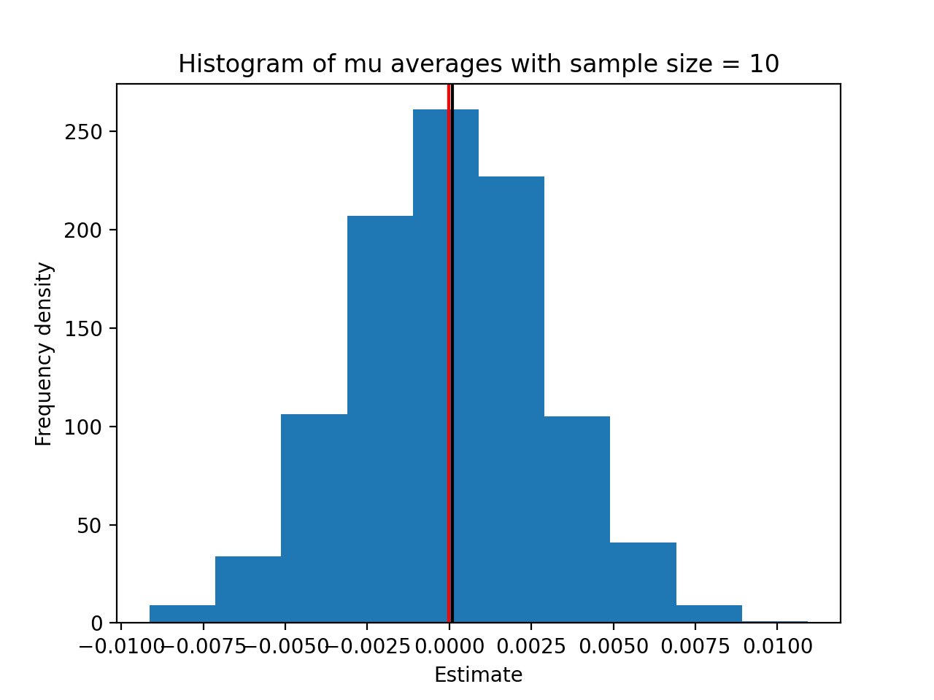
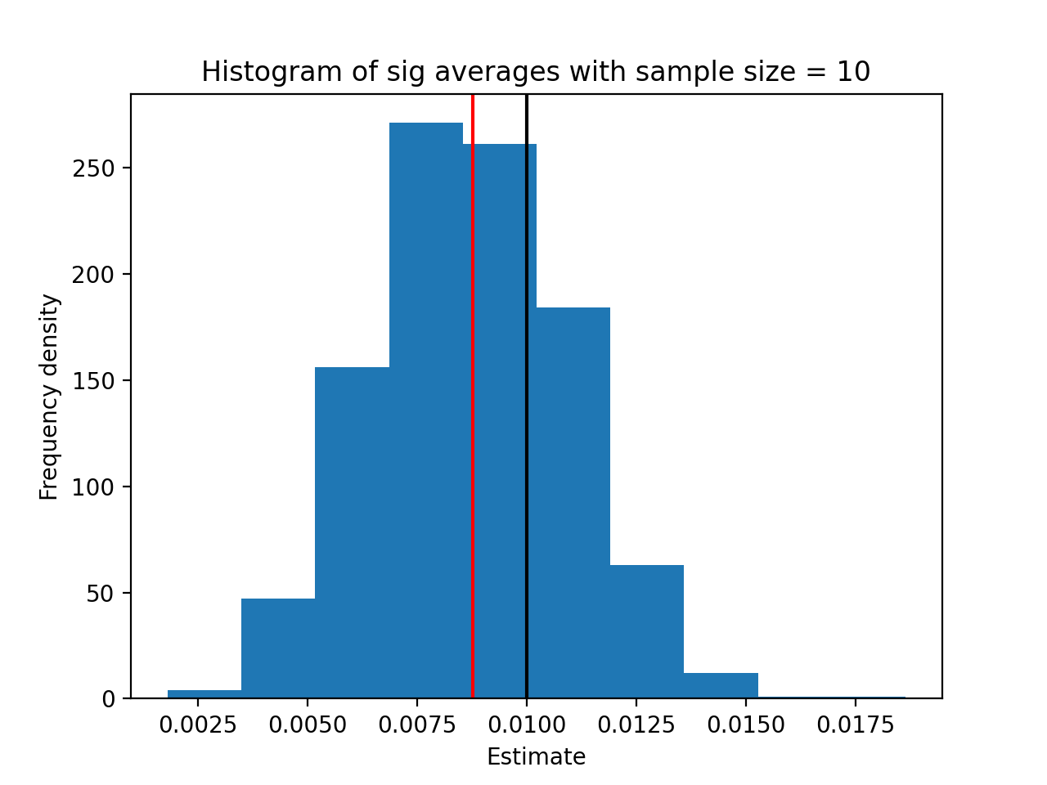
Some examples
Here we have taken mu = 0.0001, sigma = 0.01

Slide 29
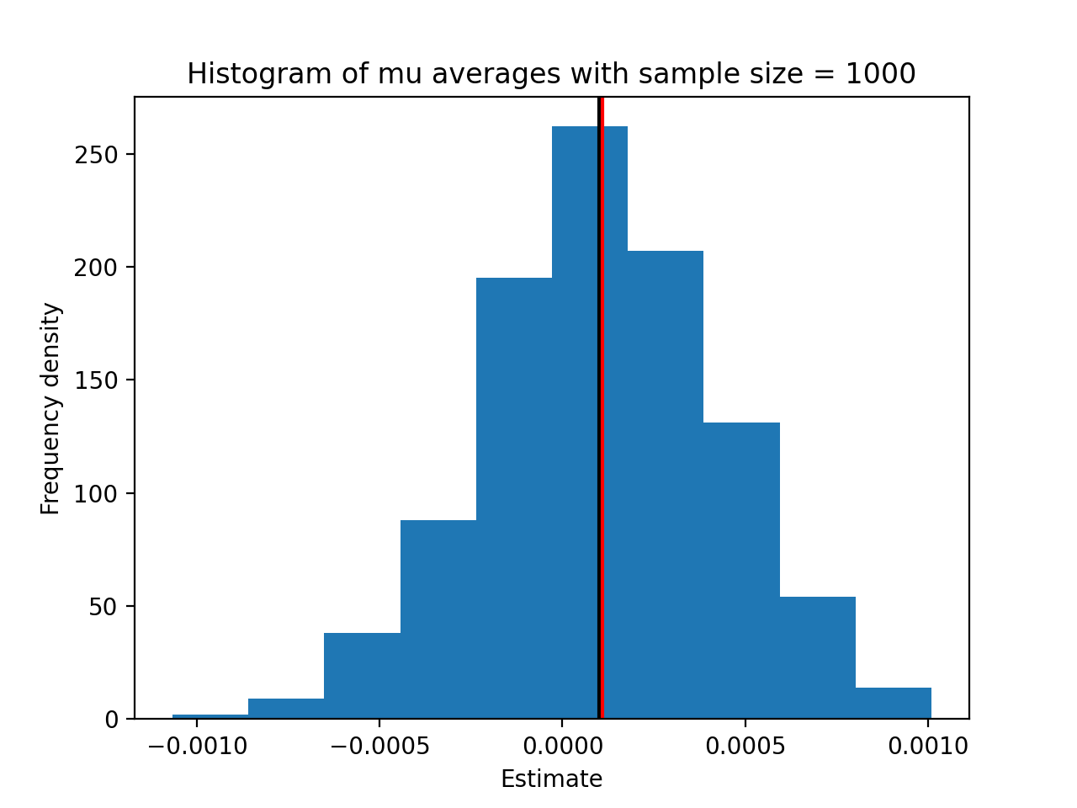
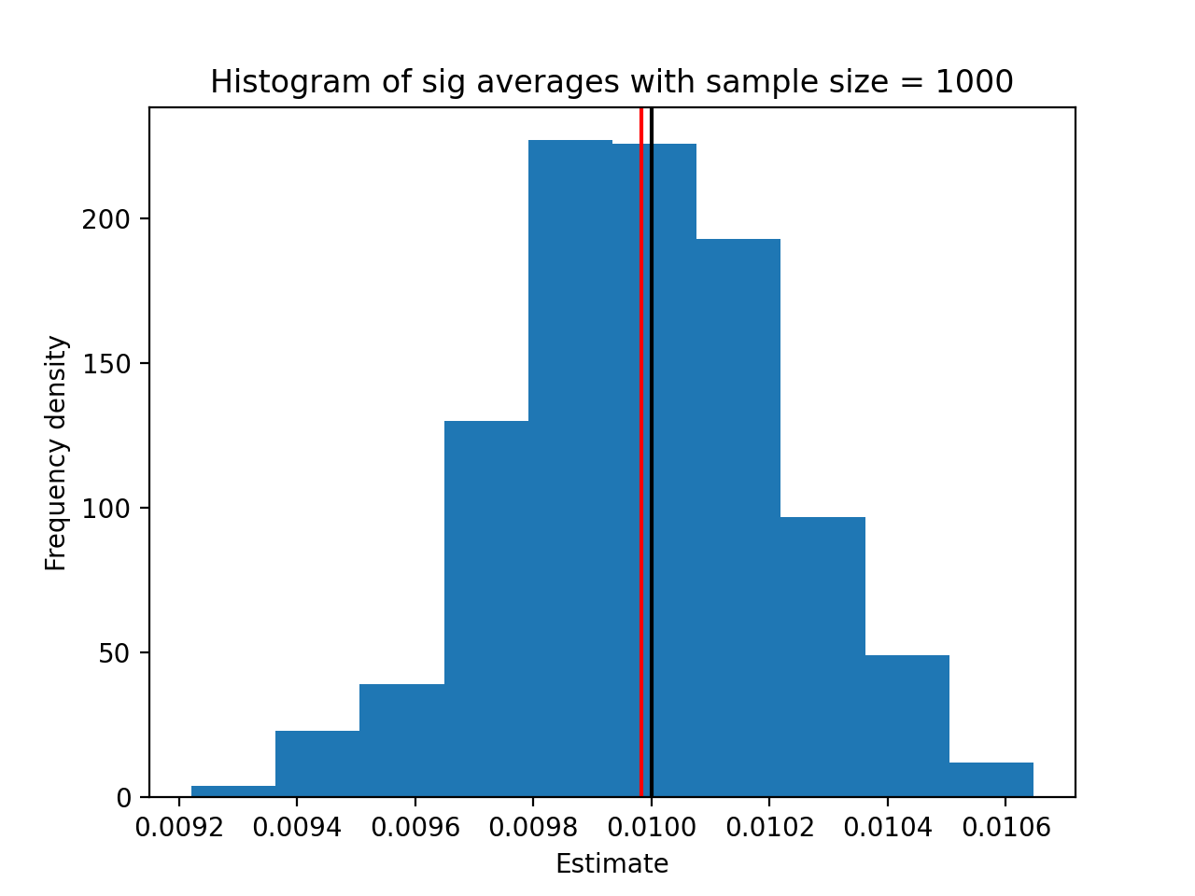
Some examples

Slide 30
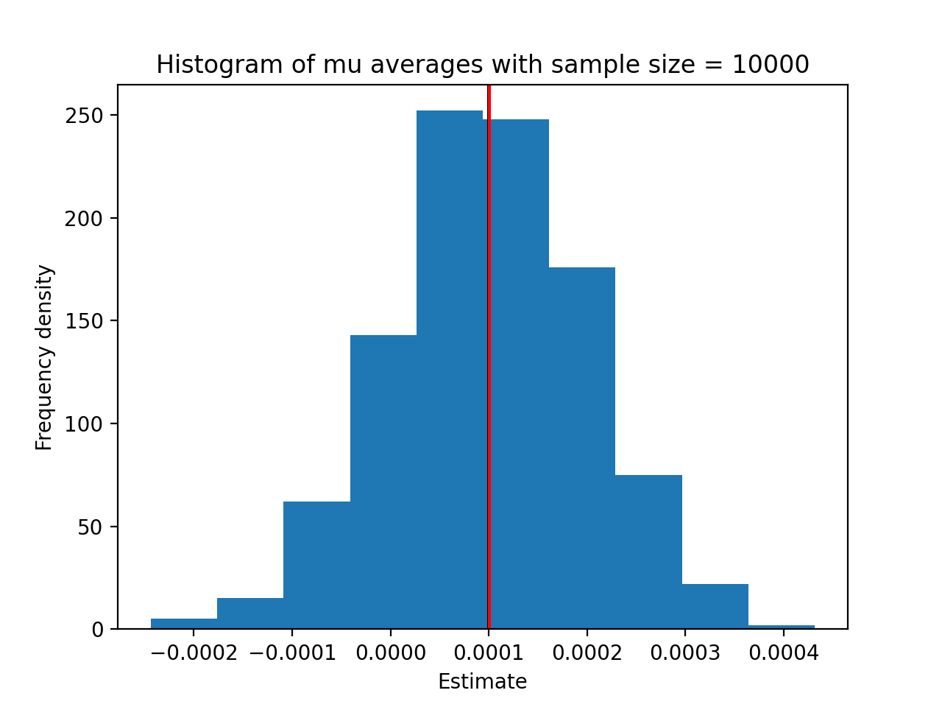
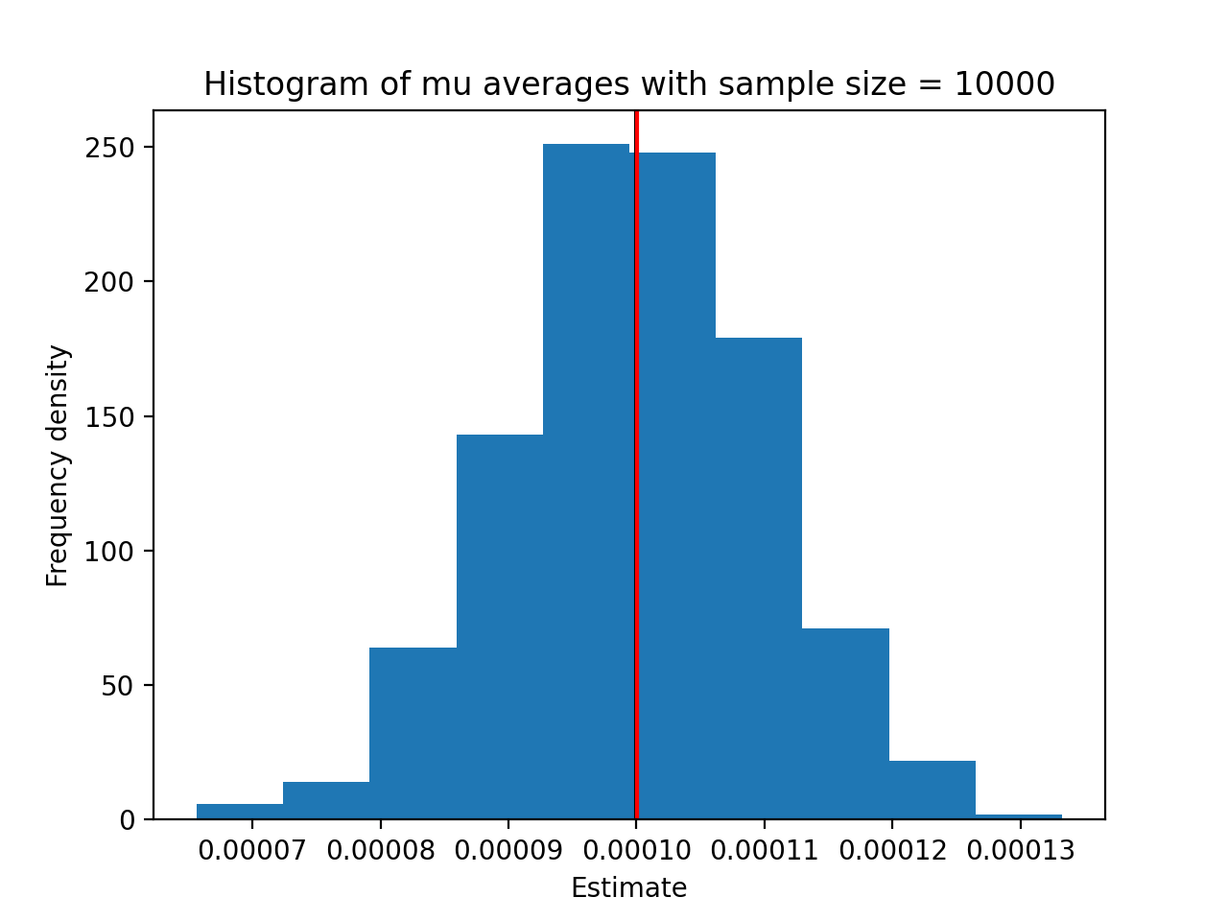
Some examples
Sig = 0.01
Sig = 0.001

Slide 31
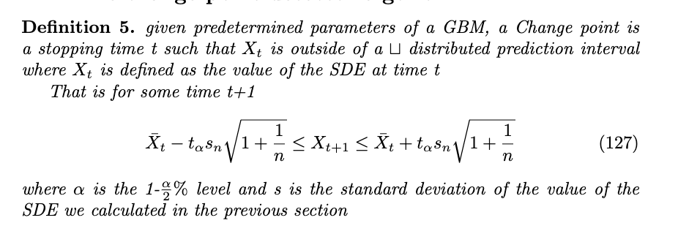
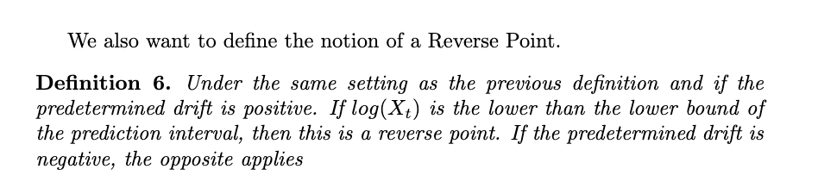
Changepoint detection

Slide 32
Changepoint detection
With these definitions we endeavoured to create an algorithm which detected change points on synthetic data and on past stock market data. We provide the python code on the next slide but here is a description of how it works
Takes a window of data and estimates drift and volatility using the MLE finder function
Takes the next data point and tests if it is within the prediction interval from the previous slide
If it is, then we label this iteration as safe and update our MLE estimates with the added data point and then repeat on the next data point
If it is not, then we detect a change point, forget the data we have used but store the MLE’s in a matrix with a drift, volatility and timestamp column we then consider the next window of data and start again.
The idea is that by estimating the MLE’s we can be more certain that a Stock is moving upwards or downwards if we spend time observing the movements first and then quantifying the movements of the window of data.

Slide 33
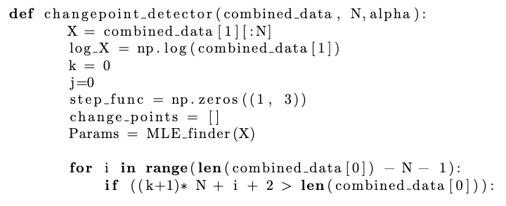
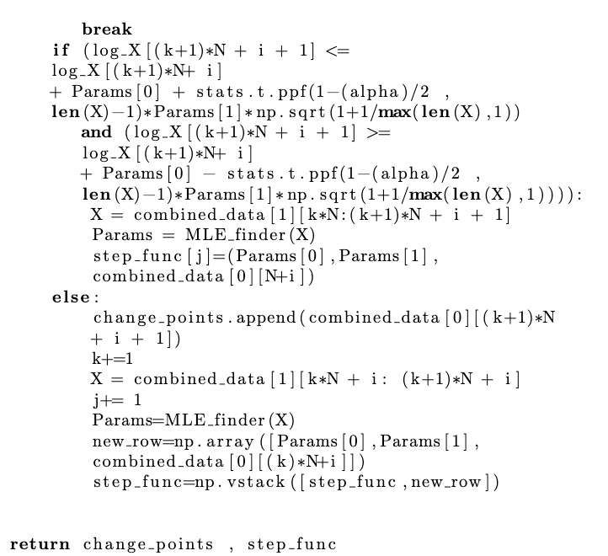
Prepares a matrix to store the MLE data
Breaks if the next window is past the end of the data frame
T interval condition
Change point detection

Slide 34
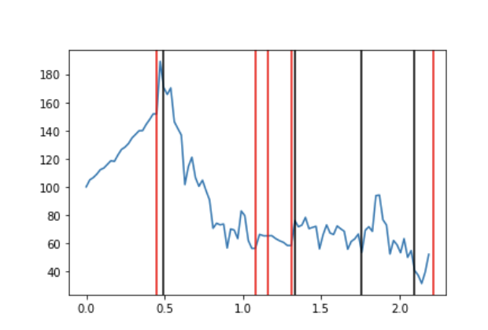
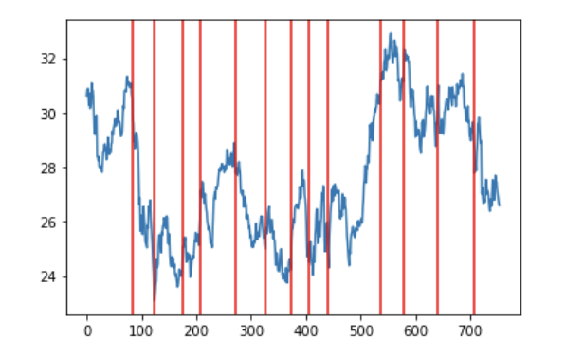
How this looks on synthetic and real data
The red lines in the plot are pre determined change points, the black are points detected by the algorithm.
On real time stock data it accurately predicts the direction of the stock with the drift term matching whether or not the value at the next changepoint is more or less than the value at the previous change point

Slide 35
How this looks on synthetic and real data
It’s important to note that in the intervals around 400, 200 and 100 we couldn’t trade for very long because the point directly after the window that the MLE’s were determined was detected as a changepoint.
This was clearly an issue as this meant our capacity to profit was capped so we decided to use the reverse point notion instead for the remainder of the code.

Slide 36
The Algorithm
Our intention was to use the functions we have defined to create a mathematically sound trading algorithm. The procedure is as follows
Consider the price data sequentially and use the reverse point detector algorithm to find reverse points in the data.
We aim to buy and hold shares until the next reverse point if the drift detected is positive and given mu there is a 0.55 probability of making profit.
We will short a stock until the next reverse point if the drift is negative and given mu there is a 0.55 chance of making profit.
We have some general conditions that we could use to detect the strength of the drift that is detected. That is we could perform a monte carlo simulation with the detected drift and volatility and only make trades if the percentage chance we profit is above a certain level for instance 0.6. This can be added if we define a predetermined time where we exit our trade, or can be estimated.
We could add in a stop loss to prevent bad decisions from ruining our portfolio.

Slide 37
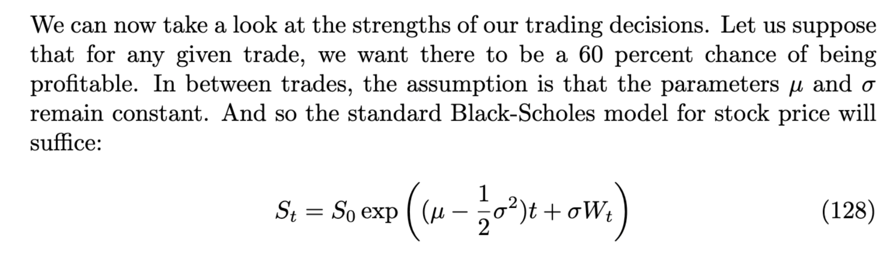
Making more decisive trades

Slide 38
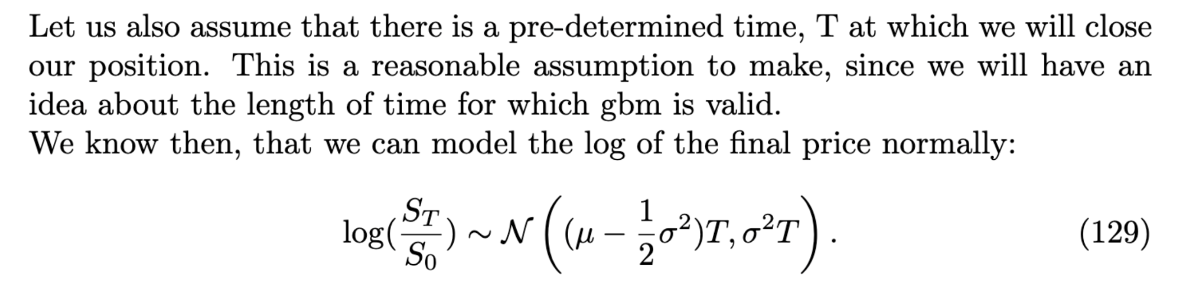
Making more decisive trades

Slide 39
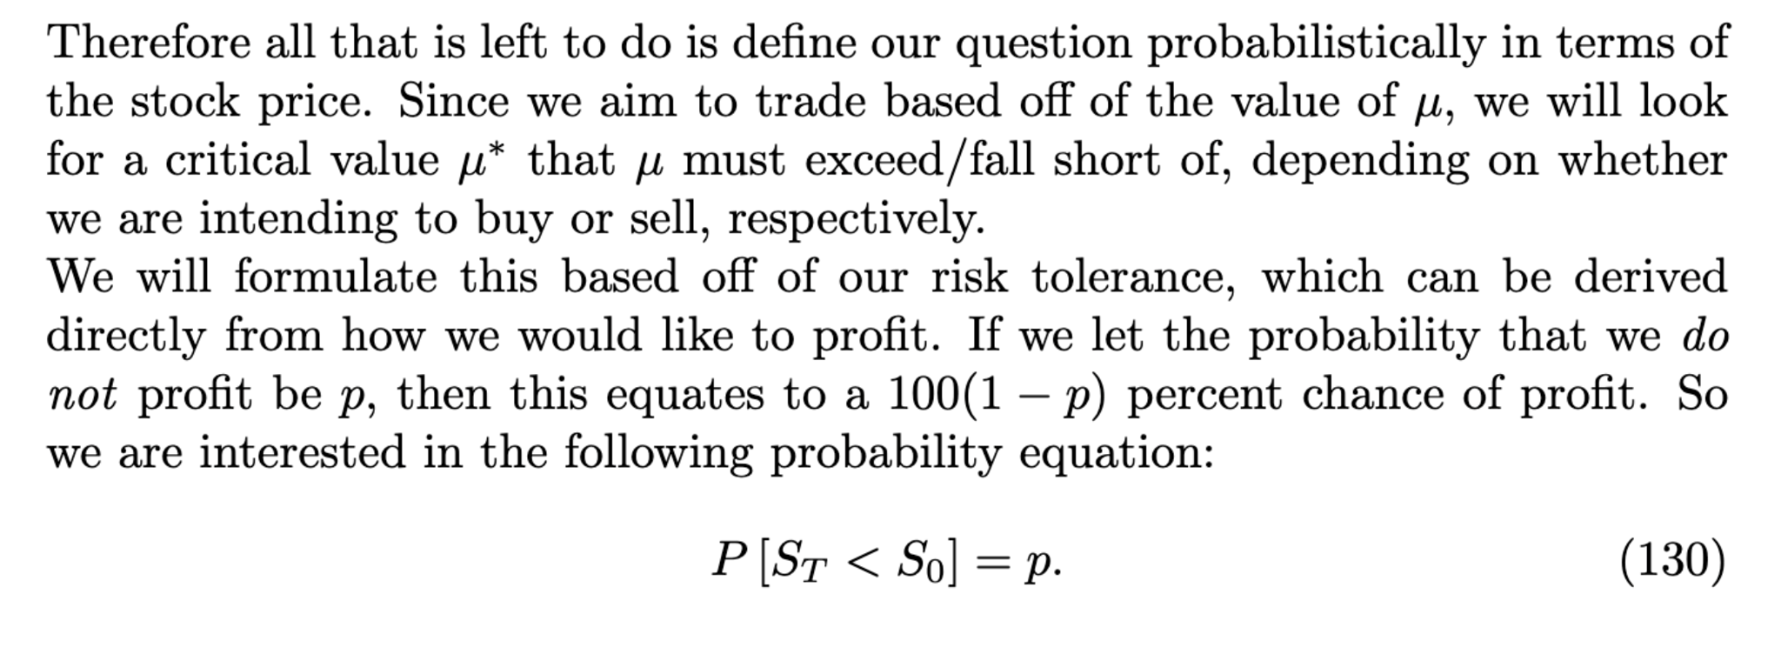
Making more decisive trades

Slide 40
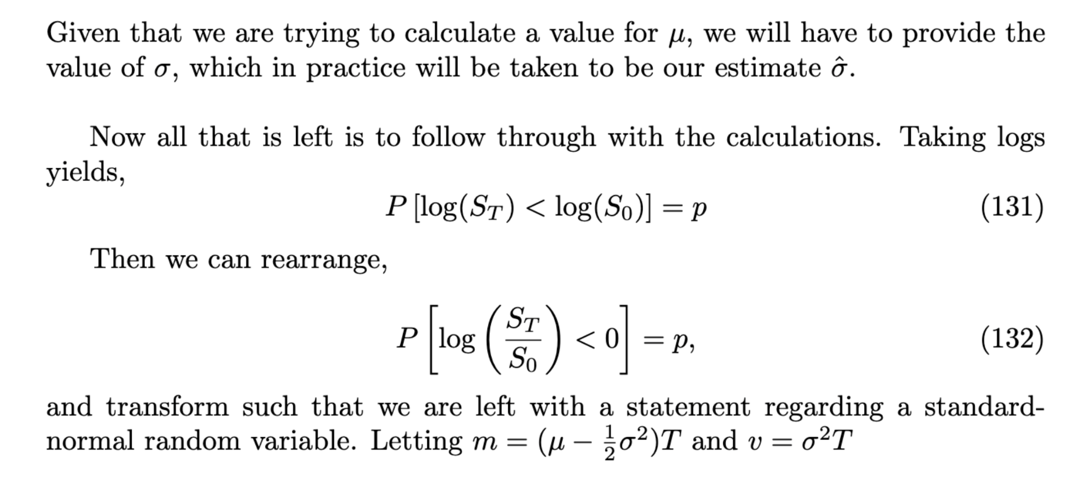
Making more decisive trades

Slide 41
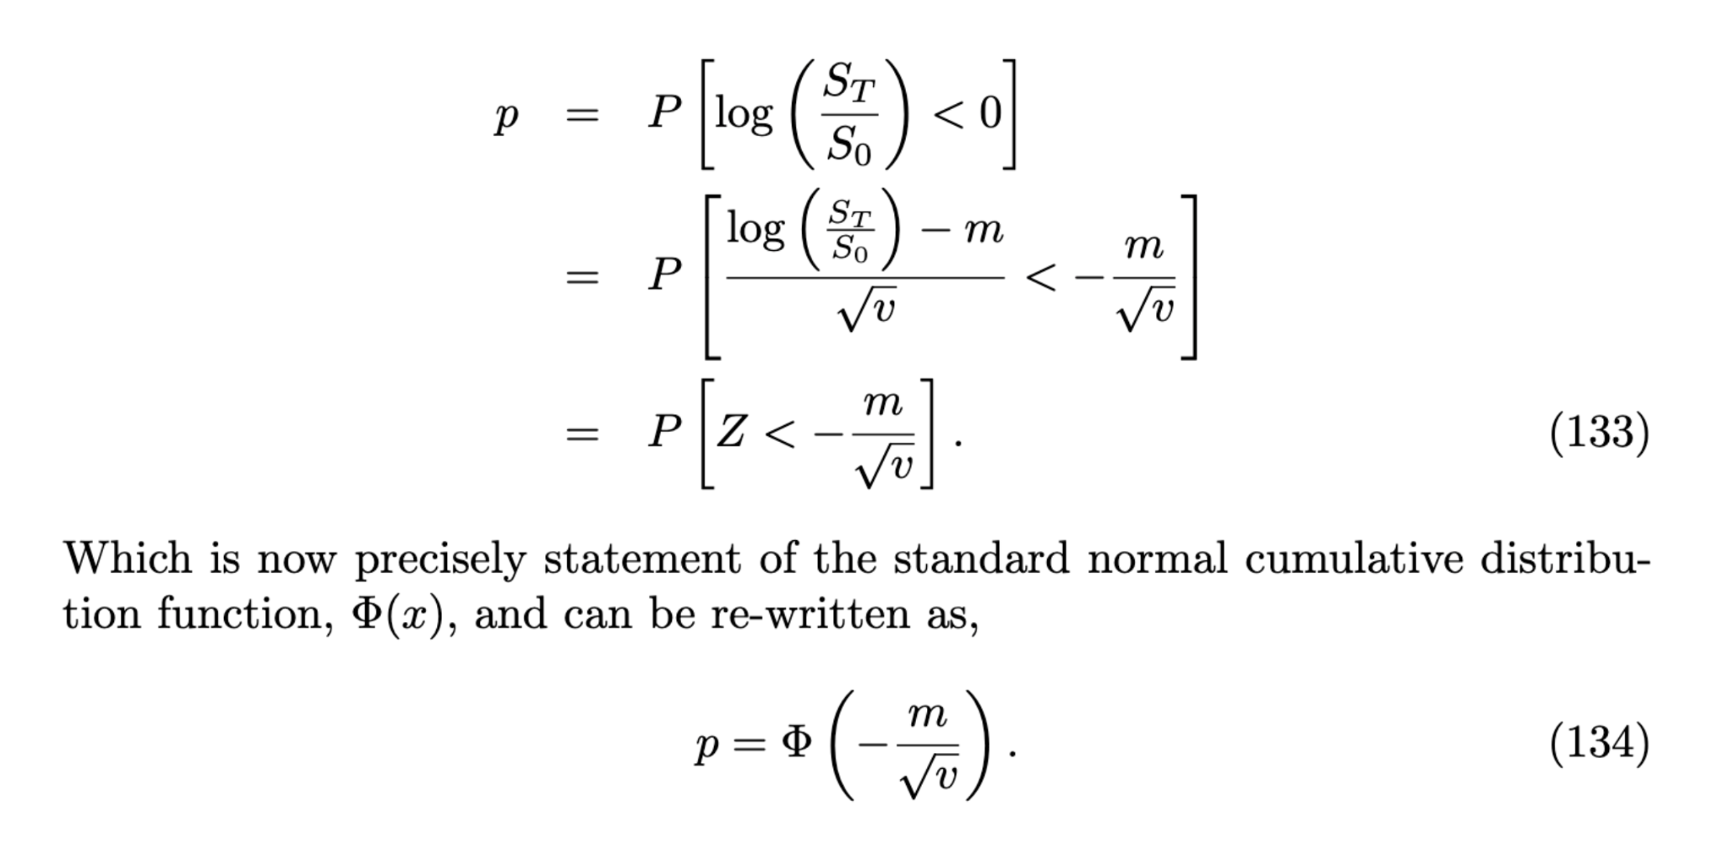
Making more decisive trades

Slide 42


Making more decisive trades

Slide 43

Backtesting Using Backtrader.py
After all of this build up, it is finally time to back-test our algorithm! To do this, we initially created our own back-test function which was easy to use and provided extremely quick end results. Some of the issues were:
We didn’t have great interpretability.
It was difficult to assess whether there were any errors.
It was a static ‘offline’ method - it didn’t need to (or could) run in real time.
It was at this point, we decided to make the move to the backtrader library in python. This provided solutions to all of the above problems as we will see. As well as provide some additional features such as:
Broker format (orders have to be placed).
Live portfolio value.
Visual indication of buy/sell order placement.

Slide 44
LIVE EXAMPLE

Slide 45

Results
Backtesting on the top 100 stocks in the S&P across a 3 week period on minute data, we produced the following results:
-0.25% average total profit.
10 stocks that were profitable in all of the 3 weeks.
Highest performer “NIO” with 12.6% profit over a 3 week period. Compared to negative buy and hold profit.

Slide 46
Possible improvements
Access to tick by tick data - much better accuracy in parameter estimates, less likely for market to change + unlikely that people can be reactive on such short intervals.
Change of model - Incorporating concepts such as fractional brownian motion & numerical techniques to accompany it + building our own version of the Black-Scholes model.
Bayesian estimation techniques - With something as complicated as the stock market, it may help to be able to incorporate prior information into our parameter estimates (help reduce the effect of noise).
More sophisticated change point detection - Change points in reality are unlikely to be defined in the manner that we chose - finding a resolution to this would help inform our decisions better.
Maximising wins & Minimising losses - A more comprehensive rule set for trading would be much more effective even with the same model. I.e, once a trade is significantly profitable we should execute and take profit rather than wait for the next change point. Similar concepts relating to stop losses/trailing stops can be applied.
Incorporating ML and A.I - A hybrid strategy would likely work best and ML can even just be used to analyse and improve our existing strategy.

Slide 47


Machine learning for trading
Although it wasn't possible to get a machine learning Ai to predict the parameters of the SDE without relying on the information that it is already brownian motion, we did use a machine learning algorithm to make trades given that there is a changepoint detected from our previous code. We also used a couple of other indicators like a simple moving average and a trend indicator.
The code is outrageously long so I will give a brief description of how it works and explain some of the results we obtained

Slide 48
Our machine learning uses a random forest. This means that they take the possible outcomes and form decision trees with various probabilities on the arcs and then average out the outcome of each decision in order to find the best decision.
In the code we define all of the necessary indicators in a pandas dataframe, namely a trend and SMA over a few different horizons, and then the information converted into 1s and 0s from the change point detection algorithm as before
We created a predict function which takes a training set of data and a testing set of data and then ran the ML.
The ML looks at the outcomes of the training set given the information we provided to it, attempts to find patterns and then uses that to make predictions based on the information it has on the test set in real time

Slide 49
Outcomes
We wanted to see the difference between using just a simple moving average and a trend indicator and then those two combined with the reverse point indicator.
Upon testing with just the SMA and the trend we found that the algorithm makes the right decision of up or down between 51% and 53% of the time on the s&p 500, this is pretty much equivalent to just waking up every day and trading randomly as the s&p 500 goes up around 53% of days
With the change point indicator included we found that it made the correct decision up to 57% of the time which although small, is a tangible increase.

Slide 50
Explanation
Although 57% doesn’t seem very large it is worth remembering that we are purely drawing from stock price data so in general, this is considered good given our information
The reason why it may seem lower than expected is due to the fact that there aren't enough reverse points for it to learn from. Inside the test data there are potentially less than 100 reverse points which is a fair amount, but not enough to rigorously learn from.
Also the fact that we are still modelling change points by GBM but we are taking daily data over the last 40 years is a massive issue, the GBM only really applies to small intervals which this is not at all

Slide 51
Where to go from here
Ideally for a machine learning algorithm we would need minute or second data over a long period of time to be able to detect more reverse points and much more accurately model with a gbm
As an extension, it might be a good idea to try and model behaviour rather than stock price. As we know stock price is a function of the portfolios that are involved, it makes a lot of sense to model the behaviour of the people who own the portfolios to attempt to predict stock movement.

Slide 52
Thanks for listening!

